Slide 1



Start your search
Get started
Notes:
#Eunice

Slide 2







Our Team
Eunice Worifah
Fandi Yi
Pascal Nguyen Tang
Shivangi Soni
Vivek Saahil
Data Scientist
Data Scientist
Product Manager
Data Analyst
Business Analyst
euniceworifah Bubbletea98 pnguyentangmcgill shivangi-soni vsaahil

Slide 3


Business Context
Airbnb provides a platform for hosts to accommodate guests with short-term lodging and tourism-related activities
Use Case: Homeowners currently employ three types of revenue management strategies:
1 – Set one price for the entire year
2 – Airbnb's Smart Pricing tool
3 – A third-party intelligent pricing tool (e.g. PriceLabs or Wheelhouse)
*Our Prediction Model
Stakeholders:
Current Hosts
Prospective Hosts
Prospective Guests
Objectives:
Build a model which enables:
Existing Airbnb Hosts to update their pricing strategy
New Airbnb Hosts to find the best and most competitive price for their property
Airbnb guests to define their budget when looking for a place to book
Notes:
Eunice

Slide 4
Hypotheses
Starbucks effect
Airbnb listings which are located in areas with a large number of Starbucks will be more expensive on average
Metro effect
Airbnb listings which are located near a subway station will be more expensive on average
Rating of Listing
An Airbnb listing’s rating does not have a significant effect on the price of the listing

Slide 5
Approach
Data Acquisition
Internal/External Sources
Data Transformation
6 data transformation tasks
Data Exploration
Visualizations
Pre-Processing
Model Building
Hyperparameter Tuning
Deployment
Flagging Missing Values
Iterative Imputation
Categorical Encoding
Correlation Analysis
Outlier Treatment
Feature Selection
Unsupervised
PCA
Supervised
AutoML
Random Forest
MLFlow (Hypoeropt) / RandomSearchCV
Docker
Pandas UI
Autoencoders
SVR,
XGBoost
GBT
Notes:
Eunice

Slide 6
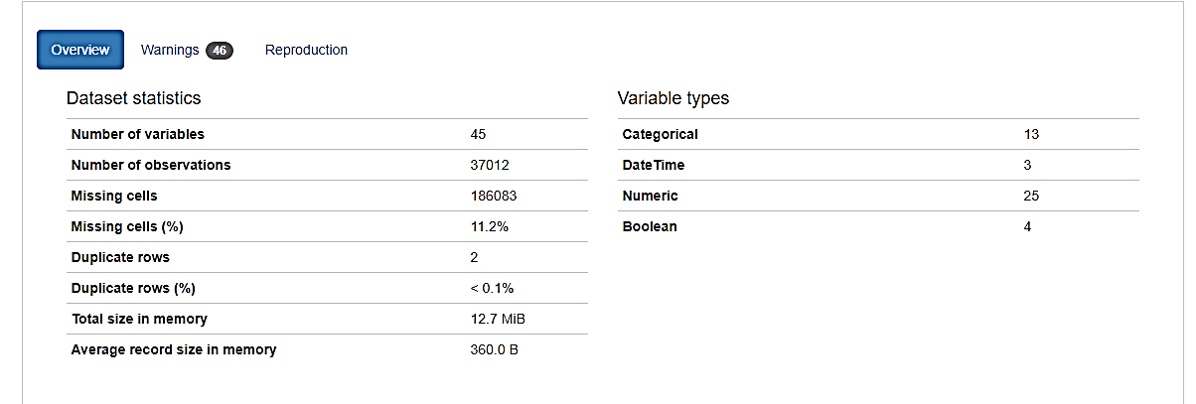
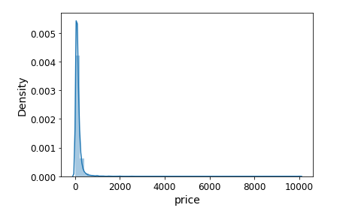
Data Acquisition
Airbnb Data
Source: http://insideairbnb.com/get-the-data.html
Starbucks Data
https://www.starbucks.com/store-locator?place=New%20York%2C%20NY%2010001%2C%20USA
Metro Data
Source: https://catalog.data.gov/en/dataset/nyc-transit-subway-entrance-and-exit-data
Notes:
Fandi

Slide 7
Data Transformation & Preprocessing
Conducted 6 data transformation tasks:
Bathroom
Separated ‘bathroom_text’ (e.g. 3.5 baths) variable into ‘num_bath’ (3.5) and ‘name_bath’ (bath)
Property Type
Grouped categories into larger buckets, e.g. ‘Townhouse’, ‘Apartment’, ‘other’, etc...
Amenities
Found the top amenities and created dummy variables
Dates
Calculated duration of listing using ‘host_since’ and ‘date_scraped’ data
Sentiment Analysis
Obtained sentiment score for descriptive values such as ‘description’, ‘host_about’, ‘neighbourhood_overview’
Metro Distance
Calculated the distance in KM from the nearest metro station to Airbnb location
Imputations and Flagging:
Flagging before imputation:
We flagged the nan value in the dataset into the new columns ( ‘Feature_name+indicator’)
Nan=1, valid =0
Numerical columns Imputation:
Applied iterative imputer in the sklearn package to impute the missing value in numerical cols
Categorical columns Imputation:
Set Nan value as the mode category
Set Nan value as the new category (ex: other, unknown)
Notes:
Fandi

Slide 8
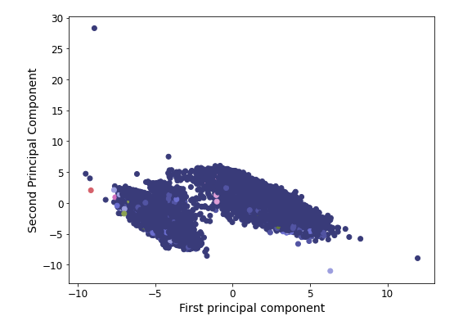
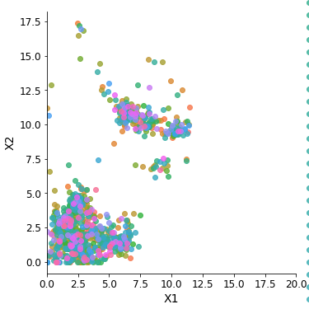
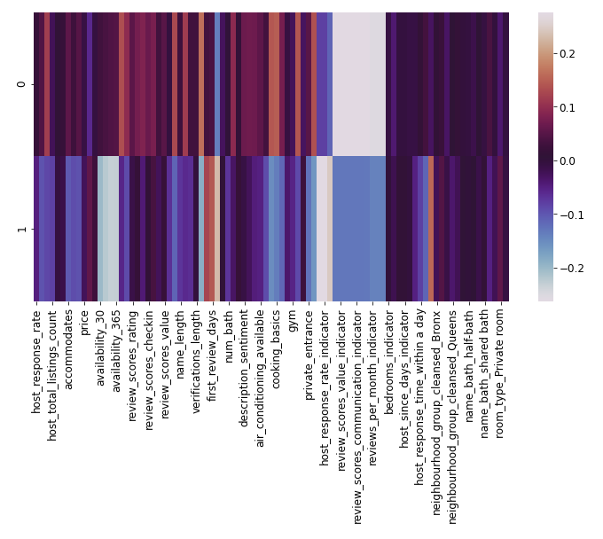
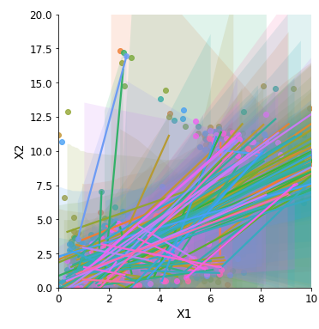
Models and Results
Results for Unsupervised Learning Models
PCA
Autoencoder
fit_reg = False
fit_reg = True
Notes:
Ss

Slide 9
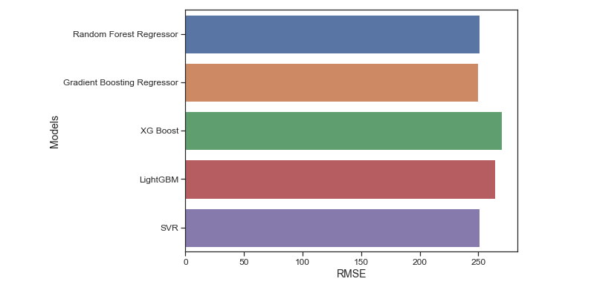
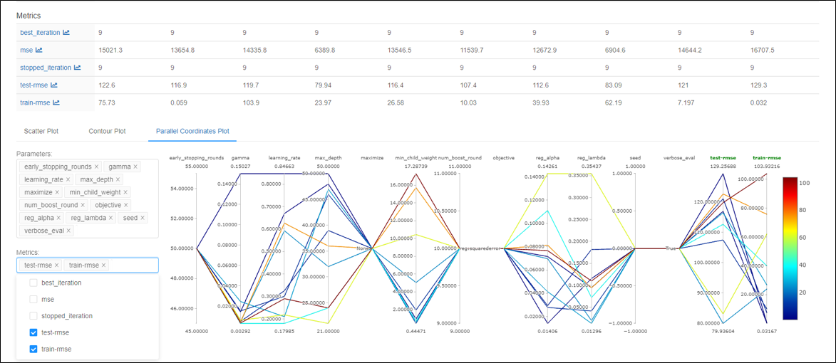
Models and Results
Results for the models to predict price of the existing listings
Recursive Feature Analysis was used to conduct feature engineering
Several models were tested
RMSE did not vary a lot between different models
ML Flow used to hypertune XG Boost model
Notes:
Ss

Slide 10
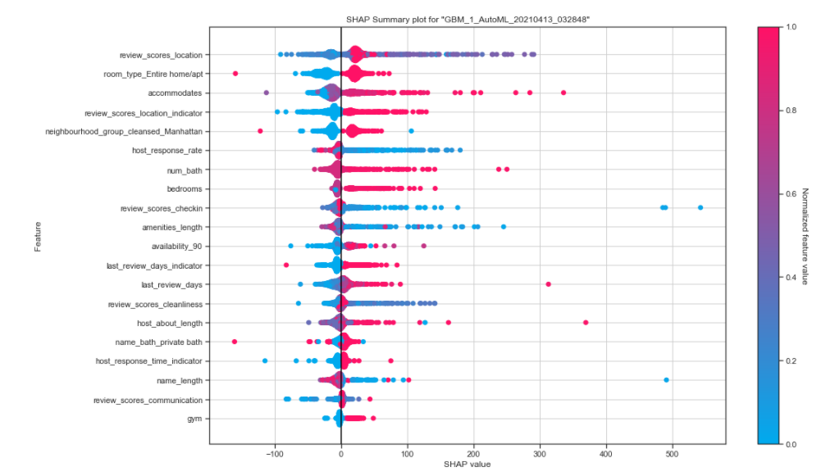
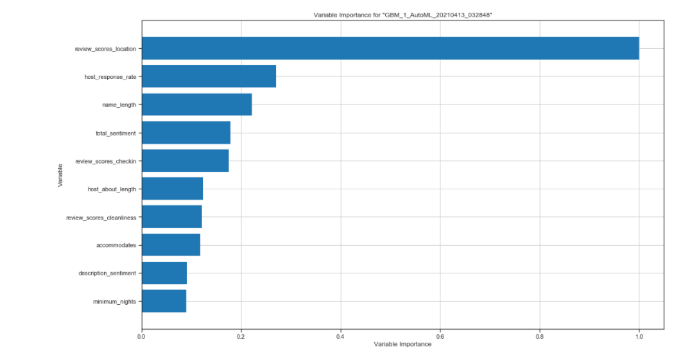
Explainability & Feature Importance – Best Model
Results for AutoML in the best performance model:
Notes:
SS

Slide 11
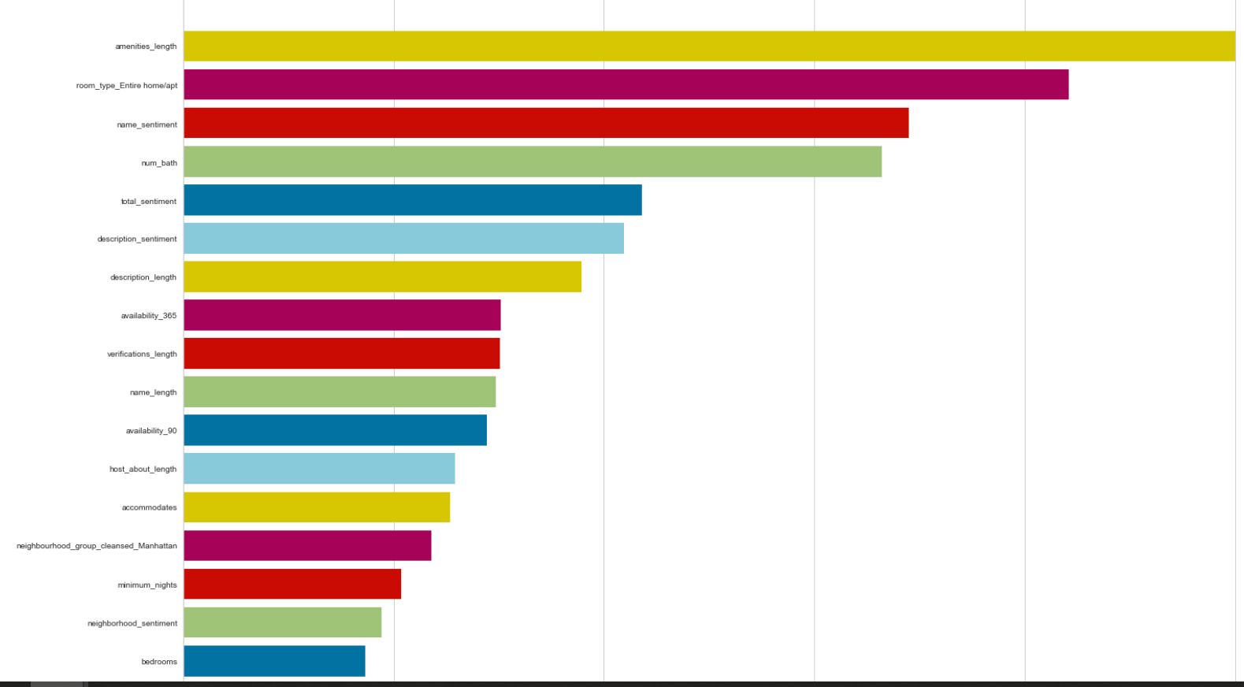
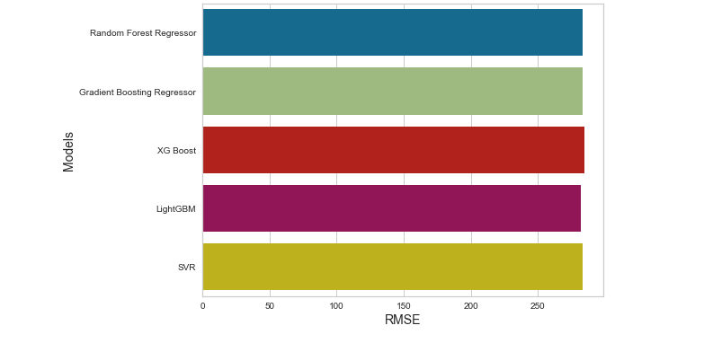
Models and Results
Results for model to predict price of new listings
All features leading to data leakage were dropped

Slide 12
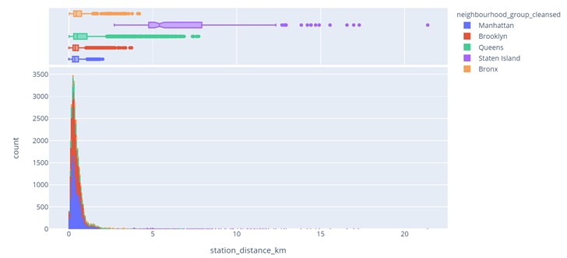
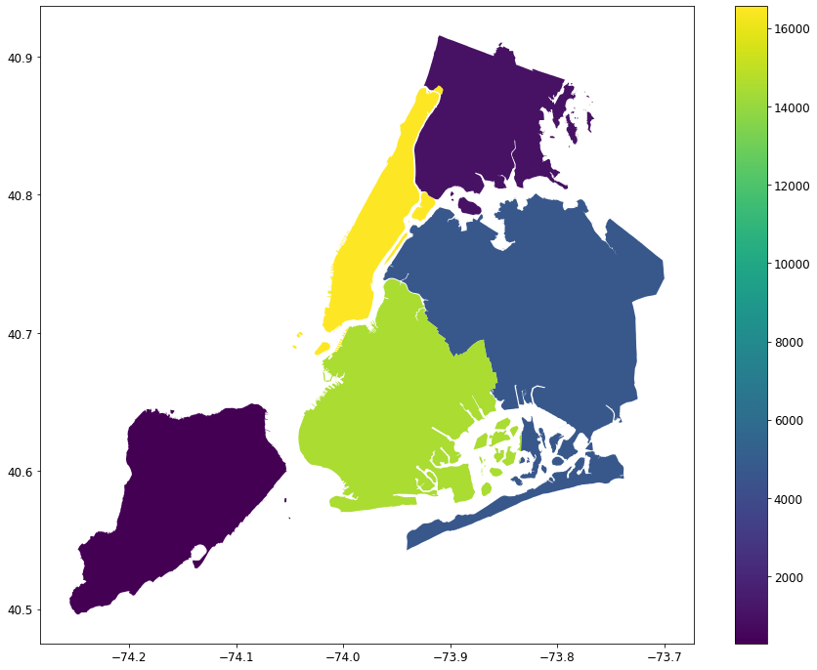
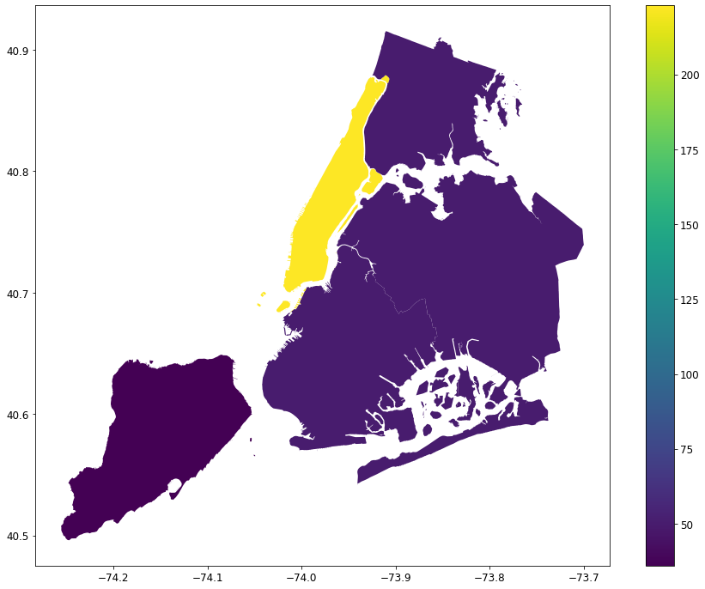
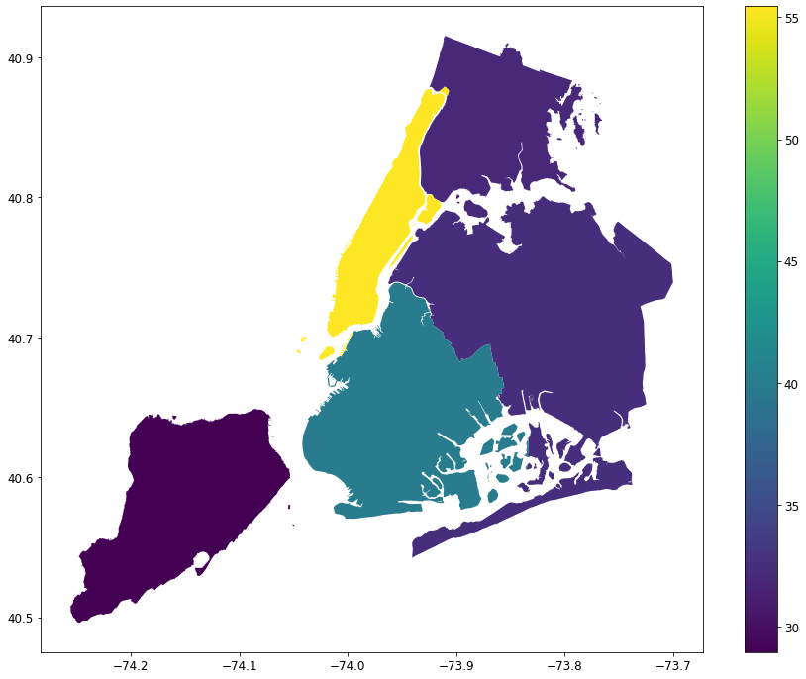
Hypothesis Results – Starbucks Effect & Station Distance
Data Exploration and Causal ML using DoWhy
Airbnb Data: http://data.insideairbnb.com/united-states/ny/new-york-city/2021-02-04/data/listings.csv.gz
Starbucks Data: https://www.starbucks.com/store-locator?place=New%20York%2C%20NY%2010001%2C%20USA
Number of Airbnbs in NY
The Distribution of the Metro Distance Across Boroughs
Price per accommod. in NY
Model 1
Number of Starbucks & Review Scores Rating
Mean value: 0.003231172176185737
p-value: 0.04047677
Inference: Significant (*)
Model 2
Closest Train Station Dist. & Review Scores Rating
Mean value: -0.002887094771580223
p-value: 0.19418372
Inference: Not Significant (.)
Model 3
Number of Starbucks & Price per accommod.
Mean value: -0.06782232293168278
p-value: 0.22349717
Inference: Not Significant (.)
Model 4
Closest Train Station Dist. & Price per accommod.
Mean value: -4.216259842350333
p-value: 0.03357141
Inference: Significant (*)
Notes:
Vivek

Slide 13
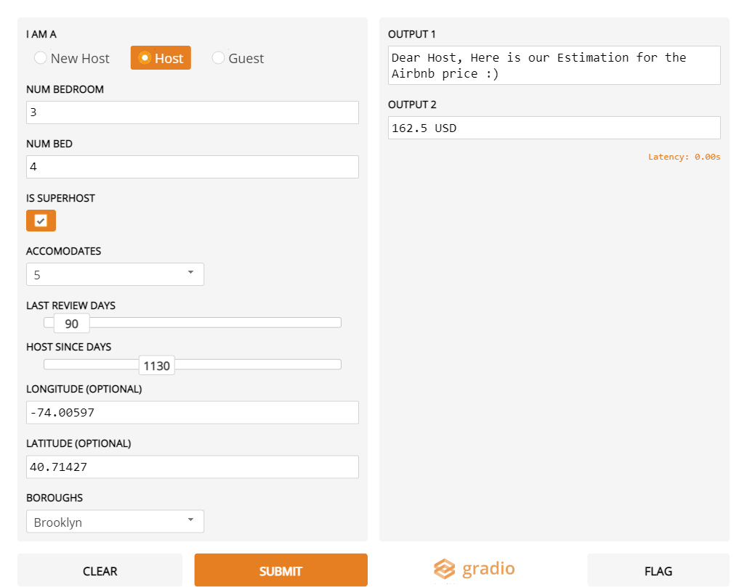
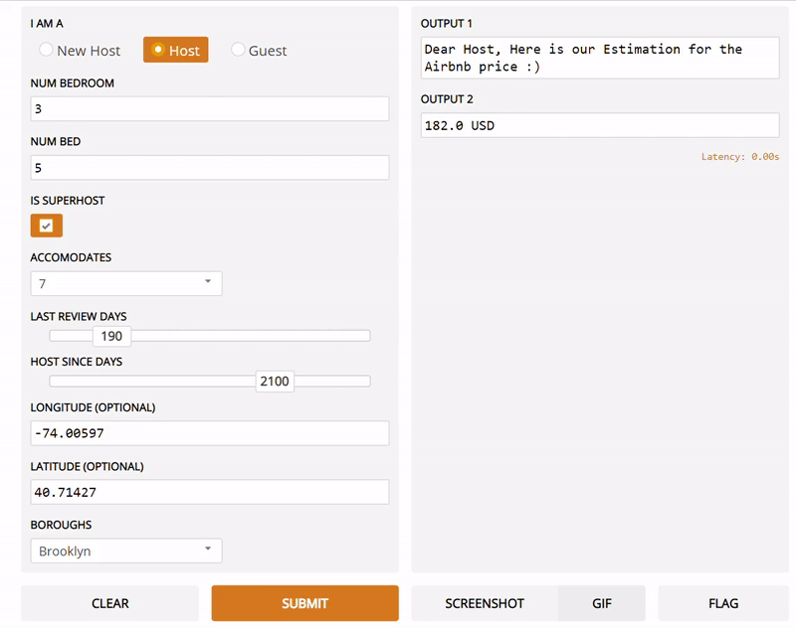
Insights and Business Implications
Homeowner
Pricing Strategies – balanced between the host, the customers and Airbnb
Gain an understanding of what features to add to a listing to increase value of property
Gain an understanding of which locations to rent/purchase a home as an investment
In our UI interface, we targeted our users to new host, host and guest.
Notes:
Vivek

Slide 14
Threats to Validity
Exogenous Shocks
Effect of COVID-19 on target variables: Historical data used does not reflect post-COVID shifts in demands, rating and prices
Effect of COVID-19 on Starbucks overlay: Due to COVID-19 restrictions on businesses, the Starbucks overlay may no longer be significant
Extraneous Factors
Omission of other potential restaurants/shops: The analysis did not include other restaurants or shops that may also have a similar effect than Starbucks
Analysis only performed on NYC: The analysis did not include other cities, for which the selected overlays may not apply
Notes:
Pascal
We identified multiple threats to validity during our project
The first section is the exogenous shocks; this designates any unexpected event that can have a severe impact on the data, with a clear distinction between the before and the after of that said event. The event in question here is the COVID-19 pandemic.
The first of those was the fact that historical data cannot reflect the post-COVID environment. In fact, as strong restrictions were imposed on travel and related activities, Airbnb saw demand for listings declining. As such, prices in the future may be skewed by this exogenous shock. This may make the model inadequate to predict price for listings that followed the COVID-19 crisis. This may also have an effect on other variables, such as demand and rating. For example, guests that find that they cannot partake in activities that would usually be available pre-COVID may have a proclivity to give a worst rating than if they were able to do the activities they had planned around their Airbnb.
Another challenge that is derived from the COVID-19 exogenous shock is the fact that the Starbucks overlay may no longer be accurate given restrictions on travel and businesses. This variable runs the risks of being highly inaccurate and no longer a impactful predictor on price listing and rating.
Extraneous factors were also identified as threats to validity. Here, they're defined as variables that are not investigated and included in the model that can affect the target variable.
The major extraneous factor that was highlighted by our analysis was that all the other restaurants and chains that could potentially have an impact on predicted price and rating of a listing were not included. Our analysis simply looked at Starbucks, but there could be other cafes and restaurants that influence the target variables as well.
Another was that the analysis was only conducted for NYC, meaning the overlays we have selected may not apply to other cities at all.
We also took a look at confounding variables. The confounding variable has a correlation with the independent variable, and a causal relationship with the dependent variable.
As for confounding variables, we realized that there could be a potential link between the two variables of interest, rating and pricing. In fact, there is a possibility that the price can influence the rating itself, which can cause challenges since the variable we are attempting to predict is the price, based on the rating among other predictors. The confounding variable is then the financial security or the spending power of the guest; for example, if they are more wealthy and had a mediocre time, it could potentially result in a less harsh rating than if the guest had shelled out a larger part of their budget.

Slide 15
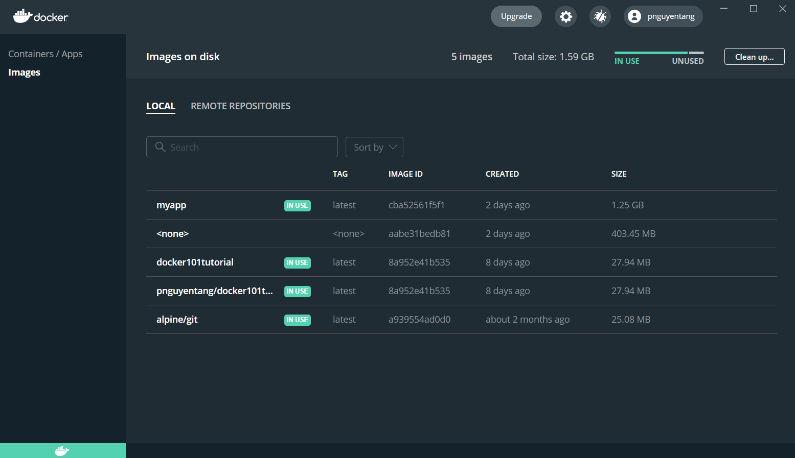

Lessons learnt & Next steps
Importance of external data
Worldwide
Utilization of standard industry tools
AutoML
MLFlow
Docker
AutoEncoder
Next Steps & Future Improvements:
Expand our model to different geographic locations and use post- pandemic data to enlarge our user base.
Docker
The infrastructure for Docker has been set up
Image containing the necessary requirements is created
Must test further to ensure the entire project can be run through the container
Notes:
This brings us to the lessons learnt & next steps
We learned that external data is extremely important to construct overlays. We realized through this project that datasets rarely come complete and cleaned, and that data engineering and preprocessing are crucial steps towards a successful machine learning project.
We also learned how to use different technologies that are standard practice in the field, like AutoML, MLFlow and Docker notably.
As for the next steps, we’re looking to use MLFlow on both models to train the hyper parameters automatically. Like Shivangi mentioned, we had made some last minute changes on our feature engineering, which made it so we have to perform our MLFlow once again.
We’re also looking into performing AutoML for our second model
We also took the time to create a separate image of our project, which was derived from a fork. We need to take some time to further test and run our project to make sure that our source code, libraries and dependencies work correctly.

Slide 16

Thank You

Slide 17
Appendix
…

Slide 18
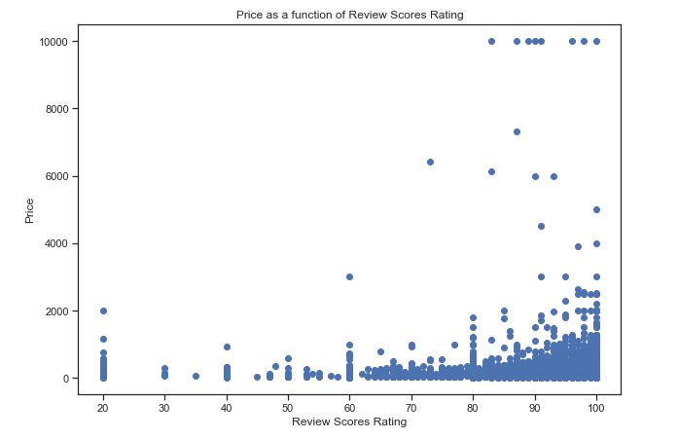
Hypothesis Results – Rating effect on Price

